Slide 1



Bike Sharing Analysis – San Francisco Bay Area
Federico Raimondi Cominesi
In partnership with
Notes:
Good Afternoon, I am Federico Raimondi and today I would like to present you my project work

Slide 2
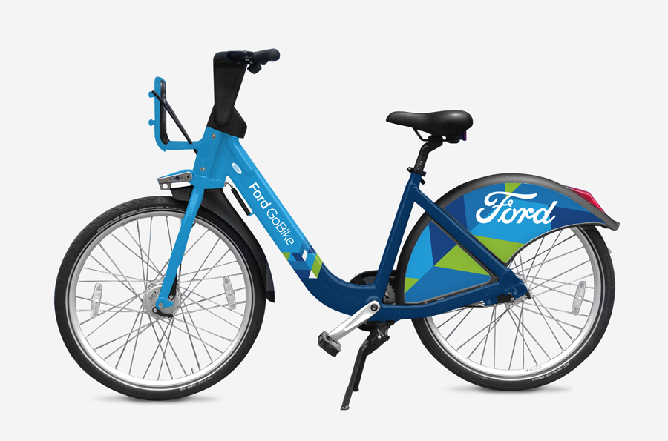
Agenda
1
ANALYSIS CONTEXT & SCOPE
2
THE DATA SCIENCE PROCESS
3
HOW DOES IT WORK?
4
BUSINESS QUESTIONS
5
THE DATASETS
6
DATA CLEANING & DATA EXPLORATION
7
IN DEPTH ANALYSIS & MODEL BUILDING
8
BUSINESS ACTIONS
9
NEW TRENDS AND OPPORTUNITIES
Notes:
First, this is the agenda for today. I will start describing the scope of the analysis, then the process that I followed with a focus on each stage. Finally, I will conclude this presentation speaking about new opportunities and trends.

Slide 3
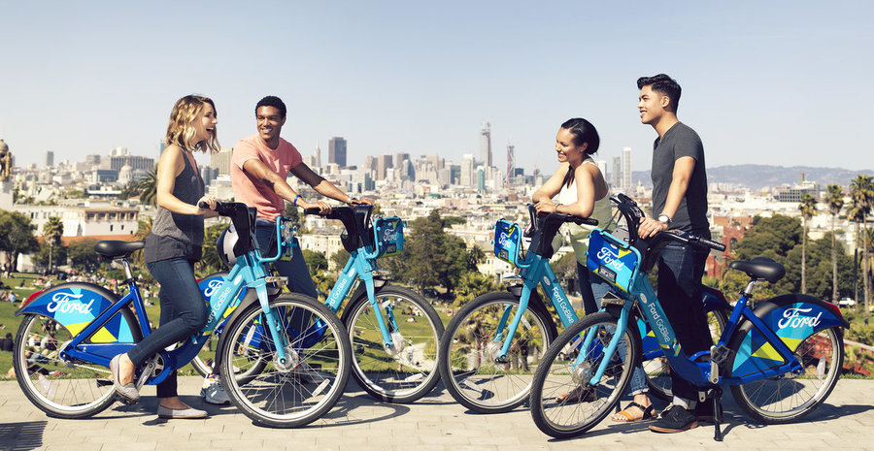









Analysis Context & Scope
BUSINESS EXPLORATION WITH A DATA MINDSET
OPPORTUNITIES
THREATS
PROCESSES IMPROVEMENT
PREDICTIVE
ANALYTICS
NEW
TRENDS
VANDALISM
MAINTENANCE
COSTS
BRANDING

Slide 4
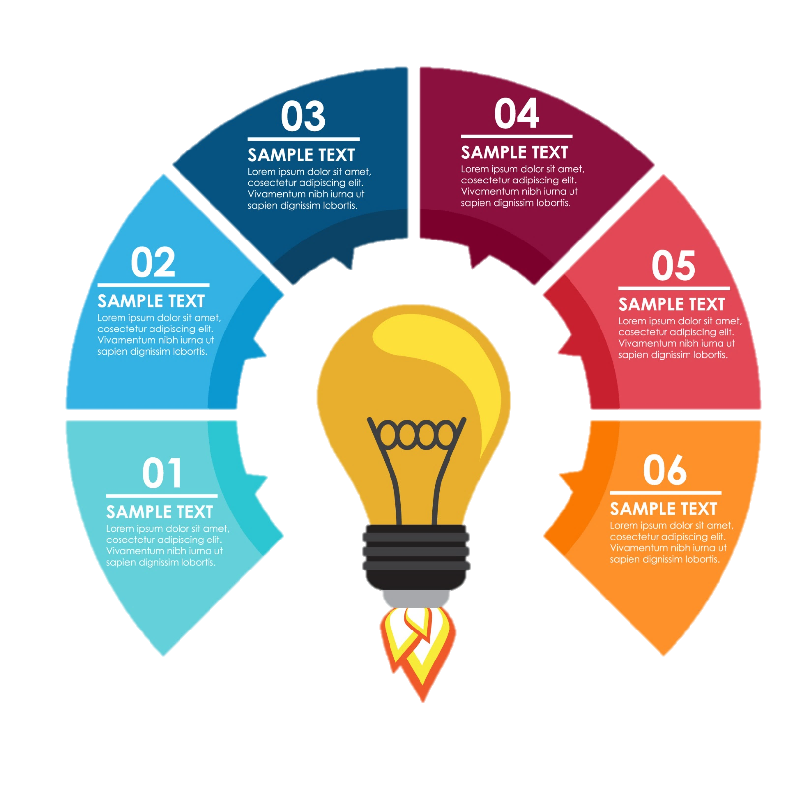






The Data Science Process
3
4
DATA
COLLECTION
DATA
CLEANING &
EXPLORATION
BUSINESS
QUESTIONS
IN-DEPTH
ANALYSIS &
MODEL
BUILDING
2
5
1
6
1
DOMAIN
UNDERSTANDING
BUSINESS
ACTIONS
DOMAIN
UNDERSTANDING

Slide 5



How does it work?
1
DOMAIN
UNDERSTANDING
USERS:
Subscriber: Frequent user with a subscription plan
Customer: Occasional user who buys single rides

Slide 6
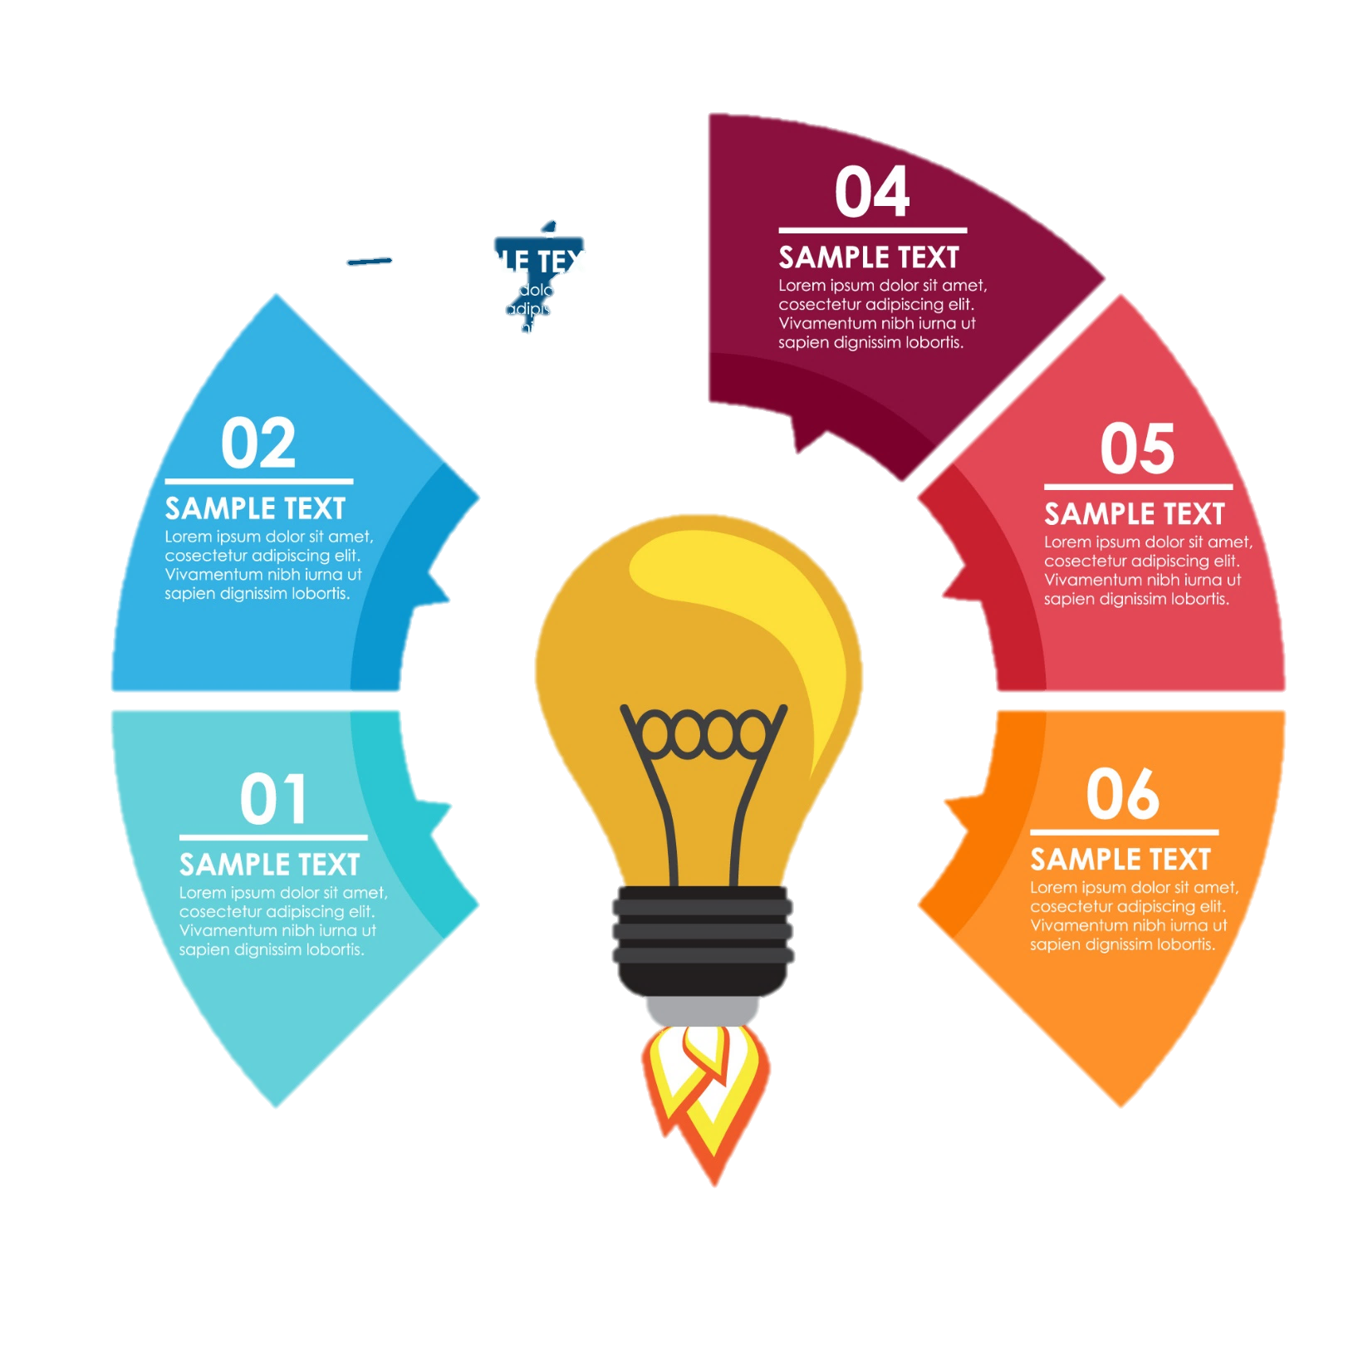




Business Questions
CAN WE SEGMENT OUR CUSTOMERS TO OFFER BETTER PROMOTIONS?
BUSINESS
QUESTIONS
2
HOW CAN WE FACE THE PROBLEM OF VANDALISM AND STOLEN BIKES?
CAN WE PREDICT HOW MANY TRIPS WILL BE DONE IN A DAY IN DIFFERENT AREAS?
IS OUR BUSINESS STILL GROWING?
ARE THERE NEW OPPORTUNITIES THAT WE COULD CATCH?

Slide 7
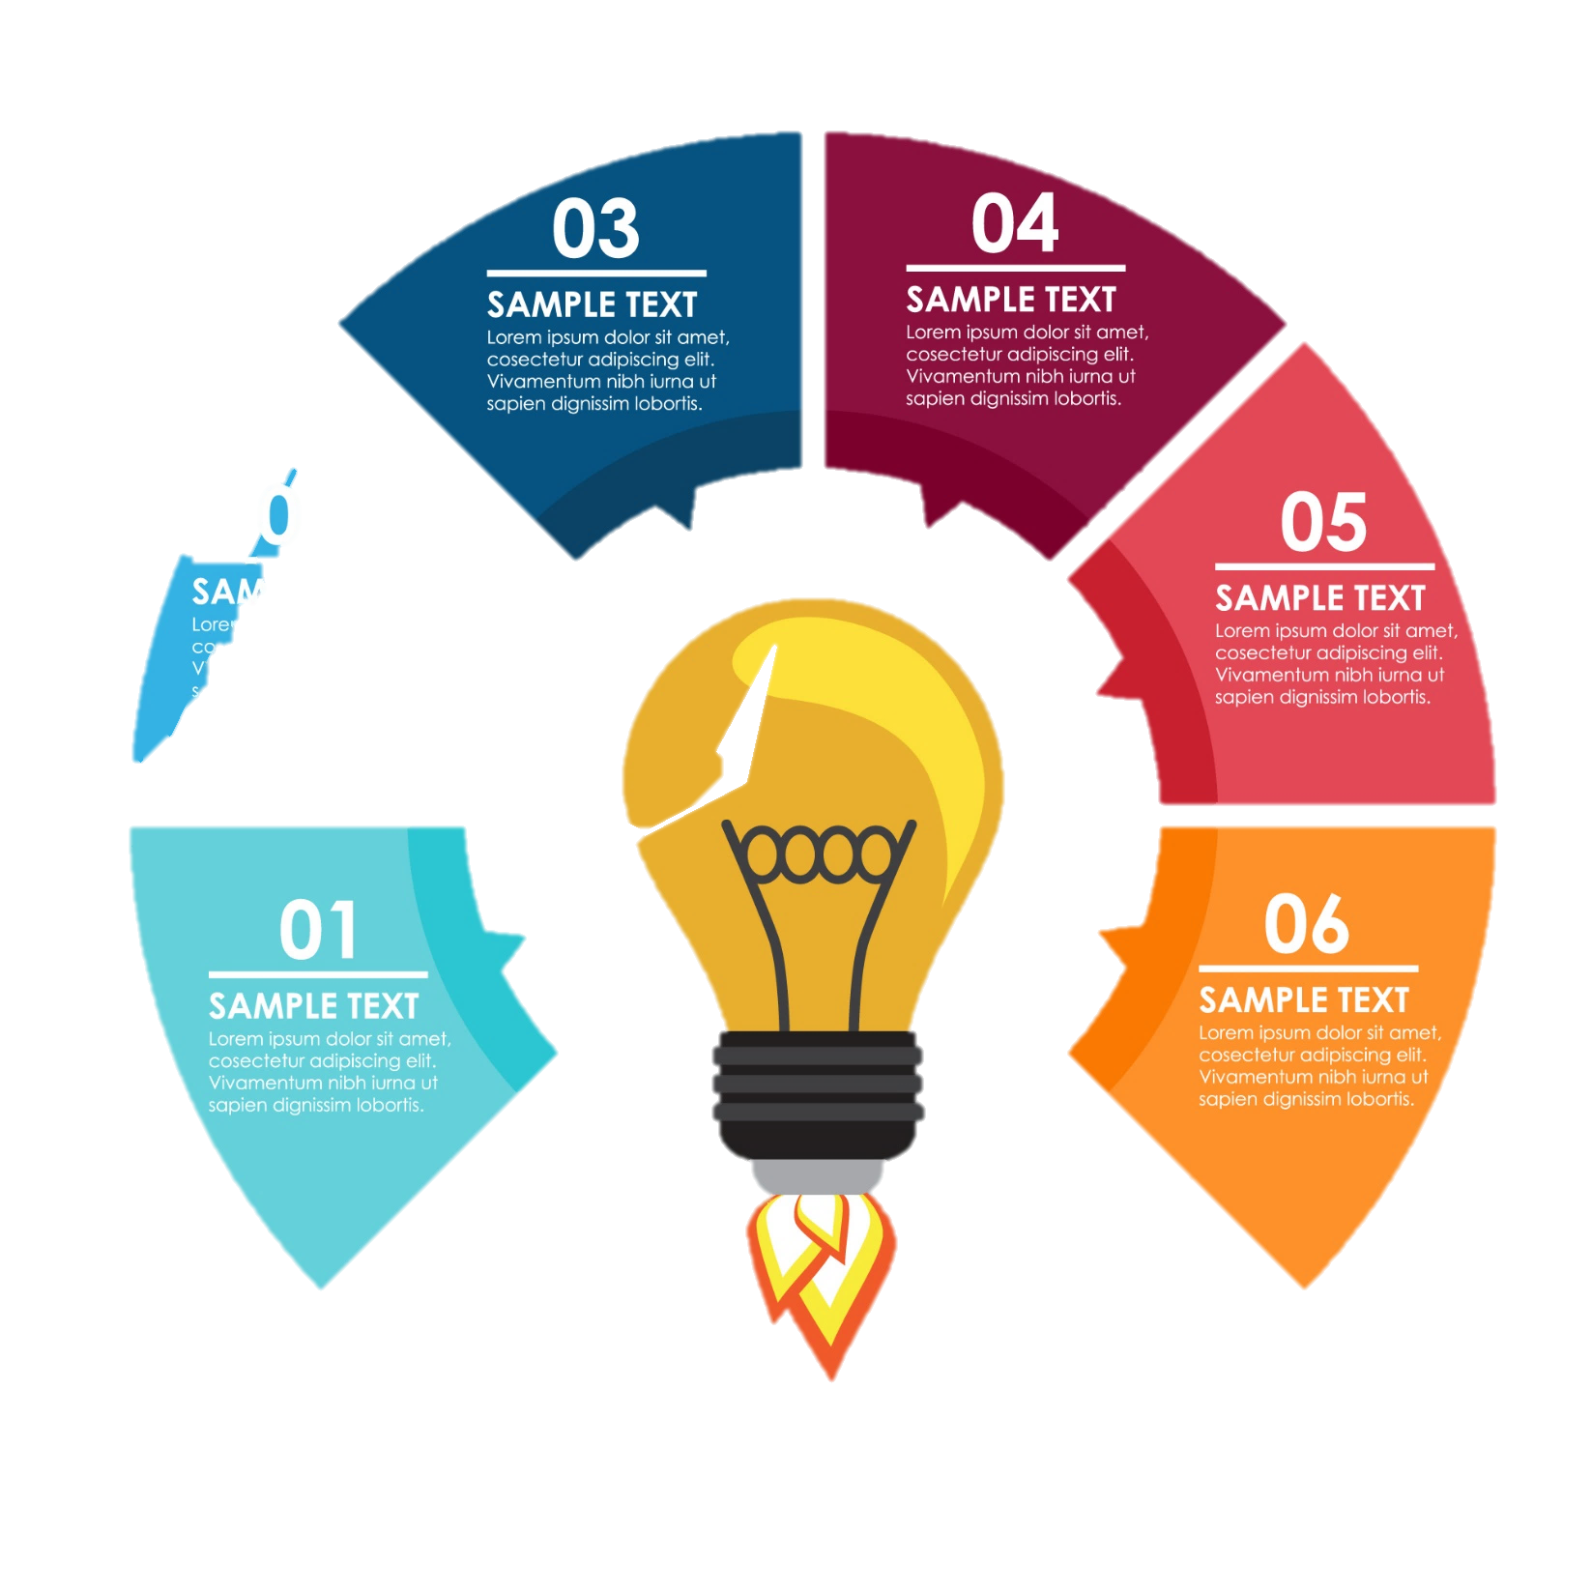

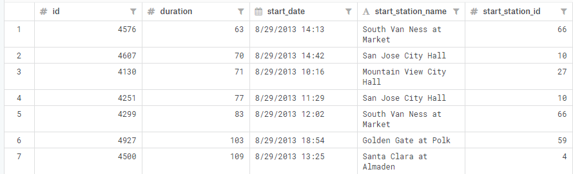
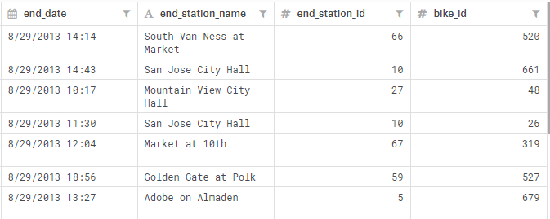
The Datasets
3
DATA
COLLECTION
1
Ford GoBike Bike-Share Data
2
Bay Area Bike-Share Data

Slide 8
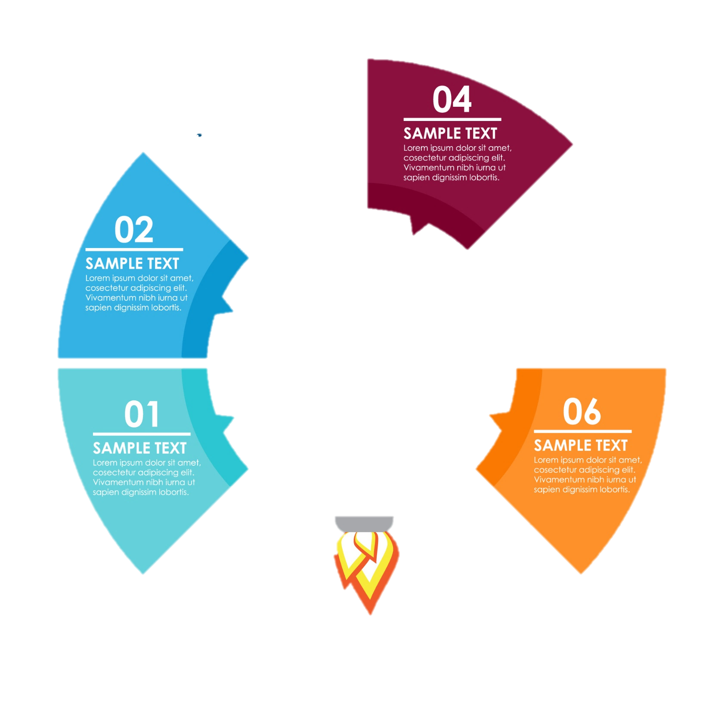



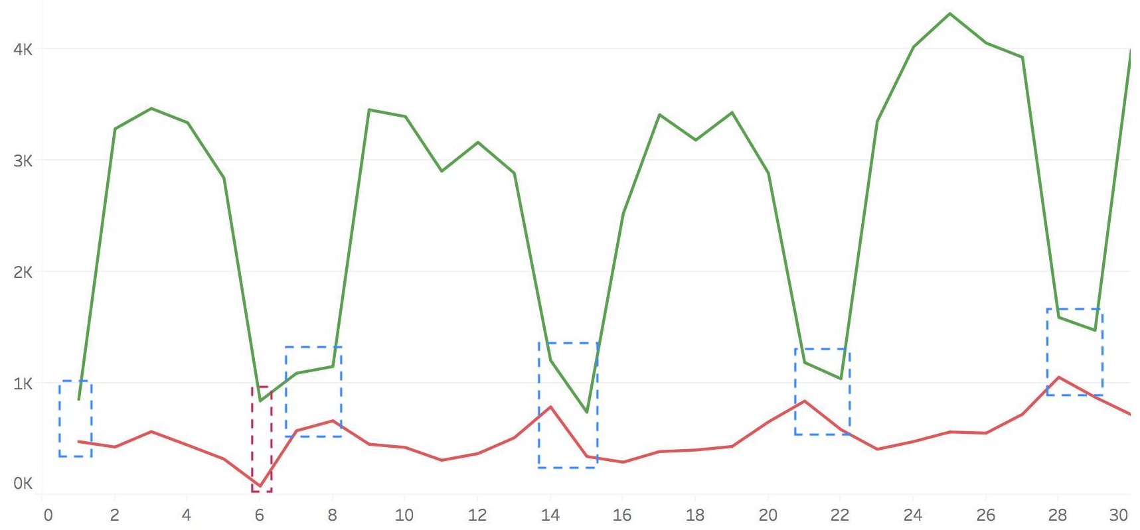
Data Cleaning
4
DATA
CLEANING &
EXPLORATION
Fixing date format in all files
Data Exploration
April 2018
Subscriber
Customer
User Count
Weekend
Outlier
DAY

Slide 9
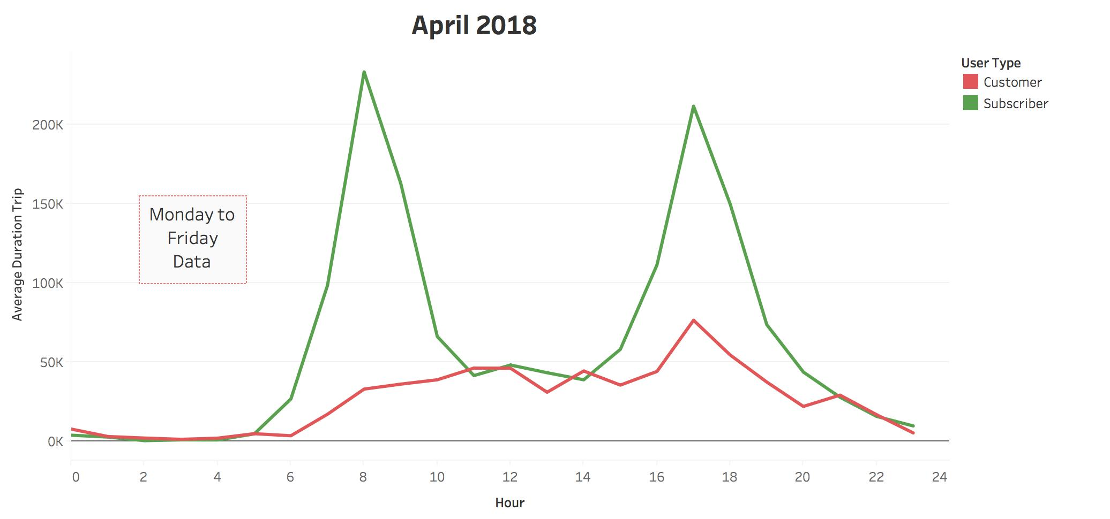
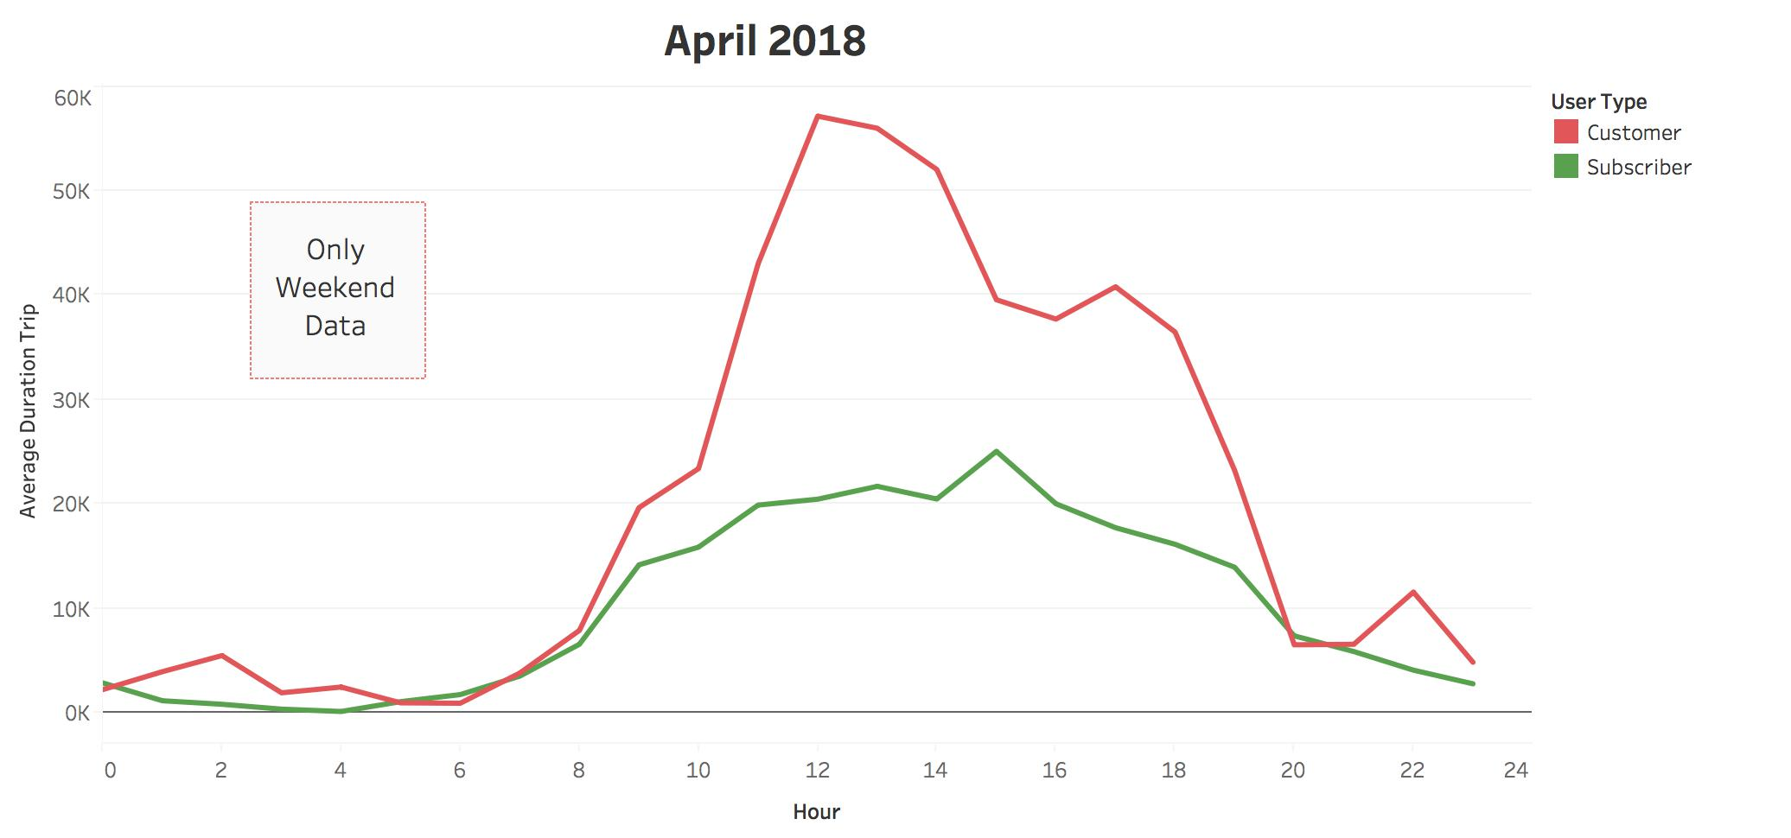
Data Exploration
4
April 2018
DATA
CLEANING &
EXPLORATION
Averaage Duration Trip (s)
April 2018
HOUR
User Type | Median Duration Trip (s)
 | 536
 | 1005.5
Averaage Duration Trip (s)
Subscriber
Customer
HOUR

Slide 10
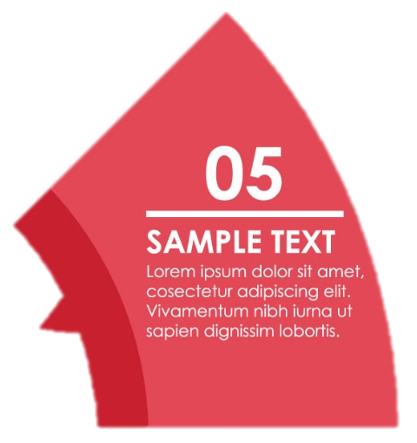

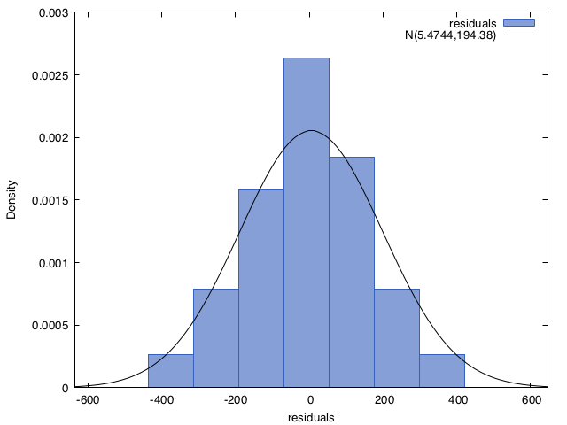
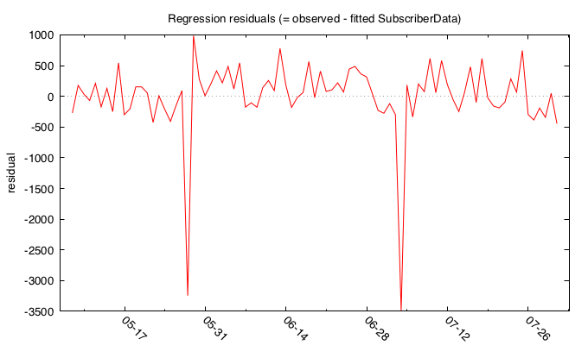
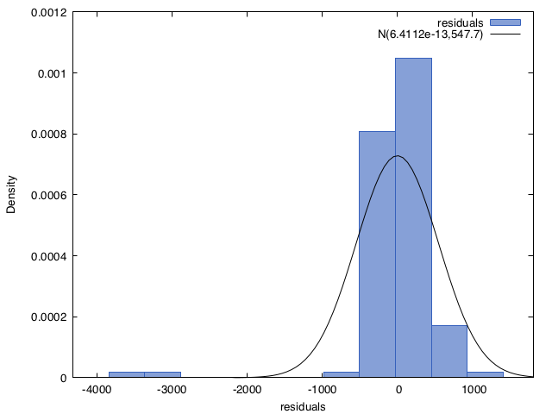
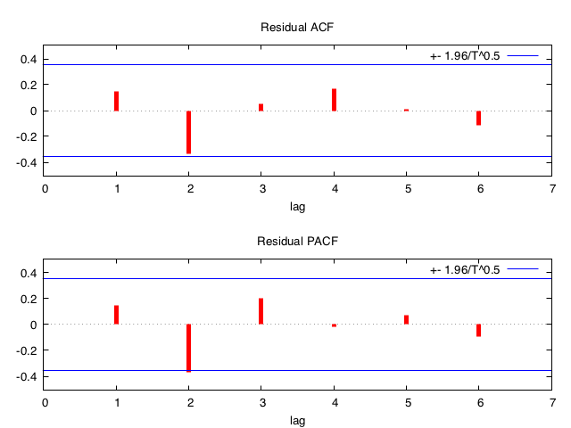
In Depth Analysis & Model Building
IN-DEPTH
ANALYSIS &
MODEL
BUILDING
5
GRETL SCRIPT
ARMA (1,0)
Normality Test
Residuals
May 28, Memorial Day
July 4, Independence Day

Slide 11
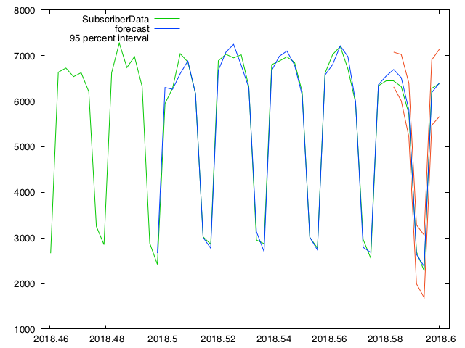
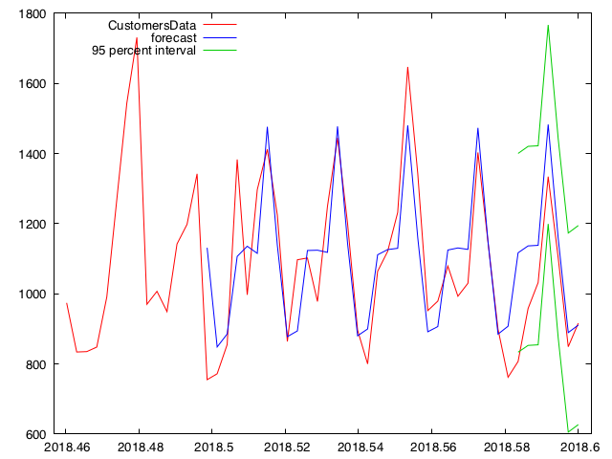
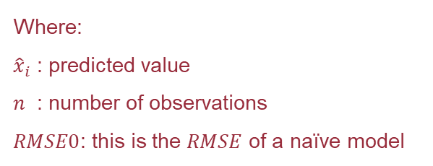
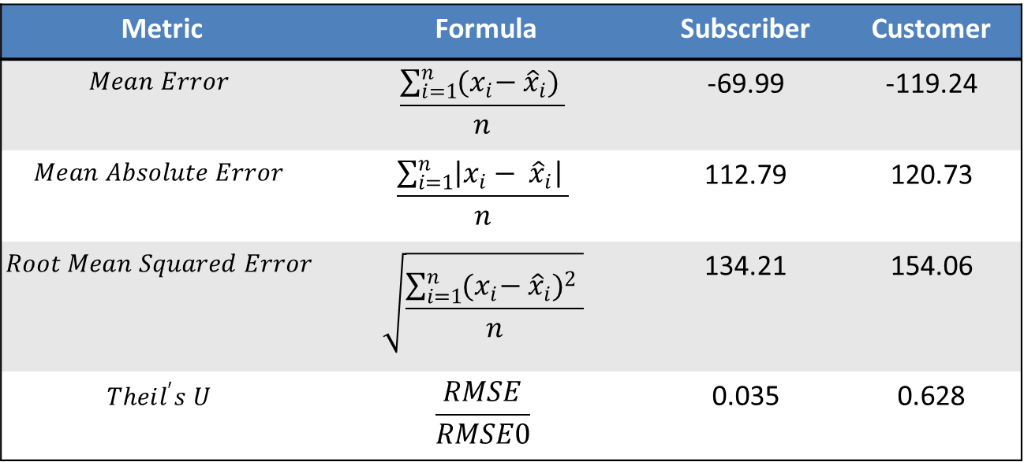
In Depth Analysis & Model Building
Predictions
IN-DEPTH
ANALYSIS &
MODEL
BUILDING
5
Metric | Formula | Subscriber | Customer
$$Mean Error$$ | $$\frac{\sum_{i=1}^{n}{{(x}_{i}− {\hat{x}}_{i}) }}{n}$$ | -69.99 | -119.24
$$Mean Absolute Error$$ | $$\frac{\sum_{i=1}^{n}{\left|x_{i}− {\hat{x}}_{i}\right| }}{n}$$ | 112.79 | 120.73
$$Root Mean Squared Error$$ | $$\sqrt{\frac{\sum_{i=1}^{n}{{{(x}_{i}− {\hat{x}}_{i})}^{2} }}{n}}$$ | 134.21 | 154.06
$$Theil^{′}s U$$ | $$\frac{RMSE}{RMSE0}$$ | 0.035 | 0.628
Customer
Subscriber
Where:
${\hat{x}}_{i}$ : predicted value
$n$ : number of observations
$RMSE0$: this is the $RMSE$ of a naïve model

Slide 12




Business Actions
6
BUSINESS
ACTIONS
Maintenance Schedule: 5-6 a.m. right before the pick
Rebalancing Schedule:
10 a.m. to 3 p.m.
Dashboard: Real-time monitoring
Resourses optimization:
Based on our predictions
Customized Promotions:
Possible integration with a
churn analysis

Slide 13

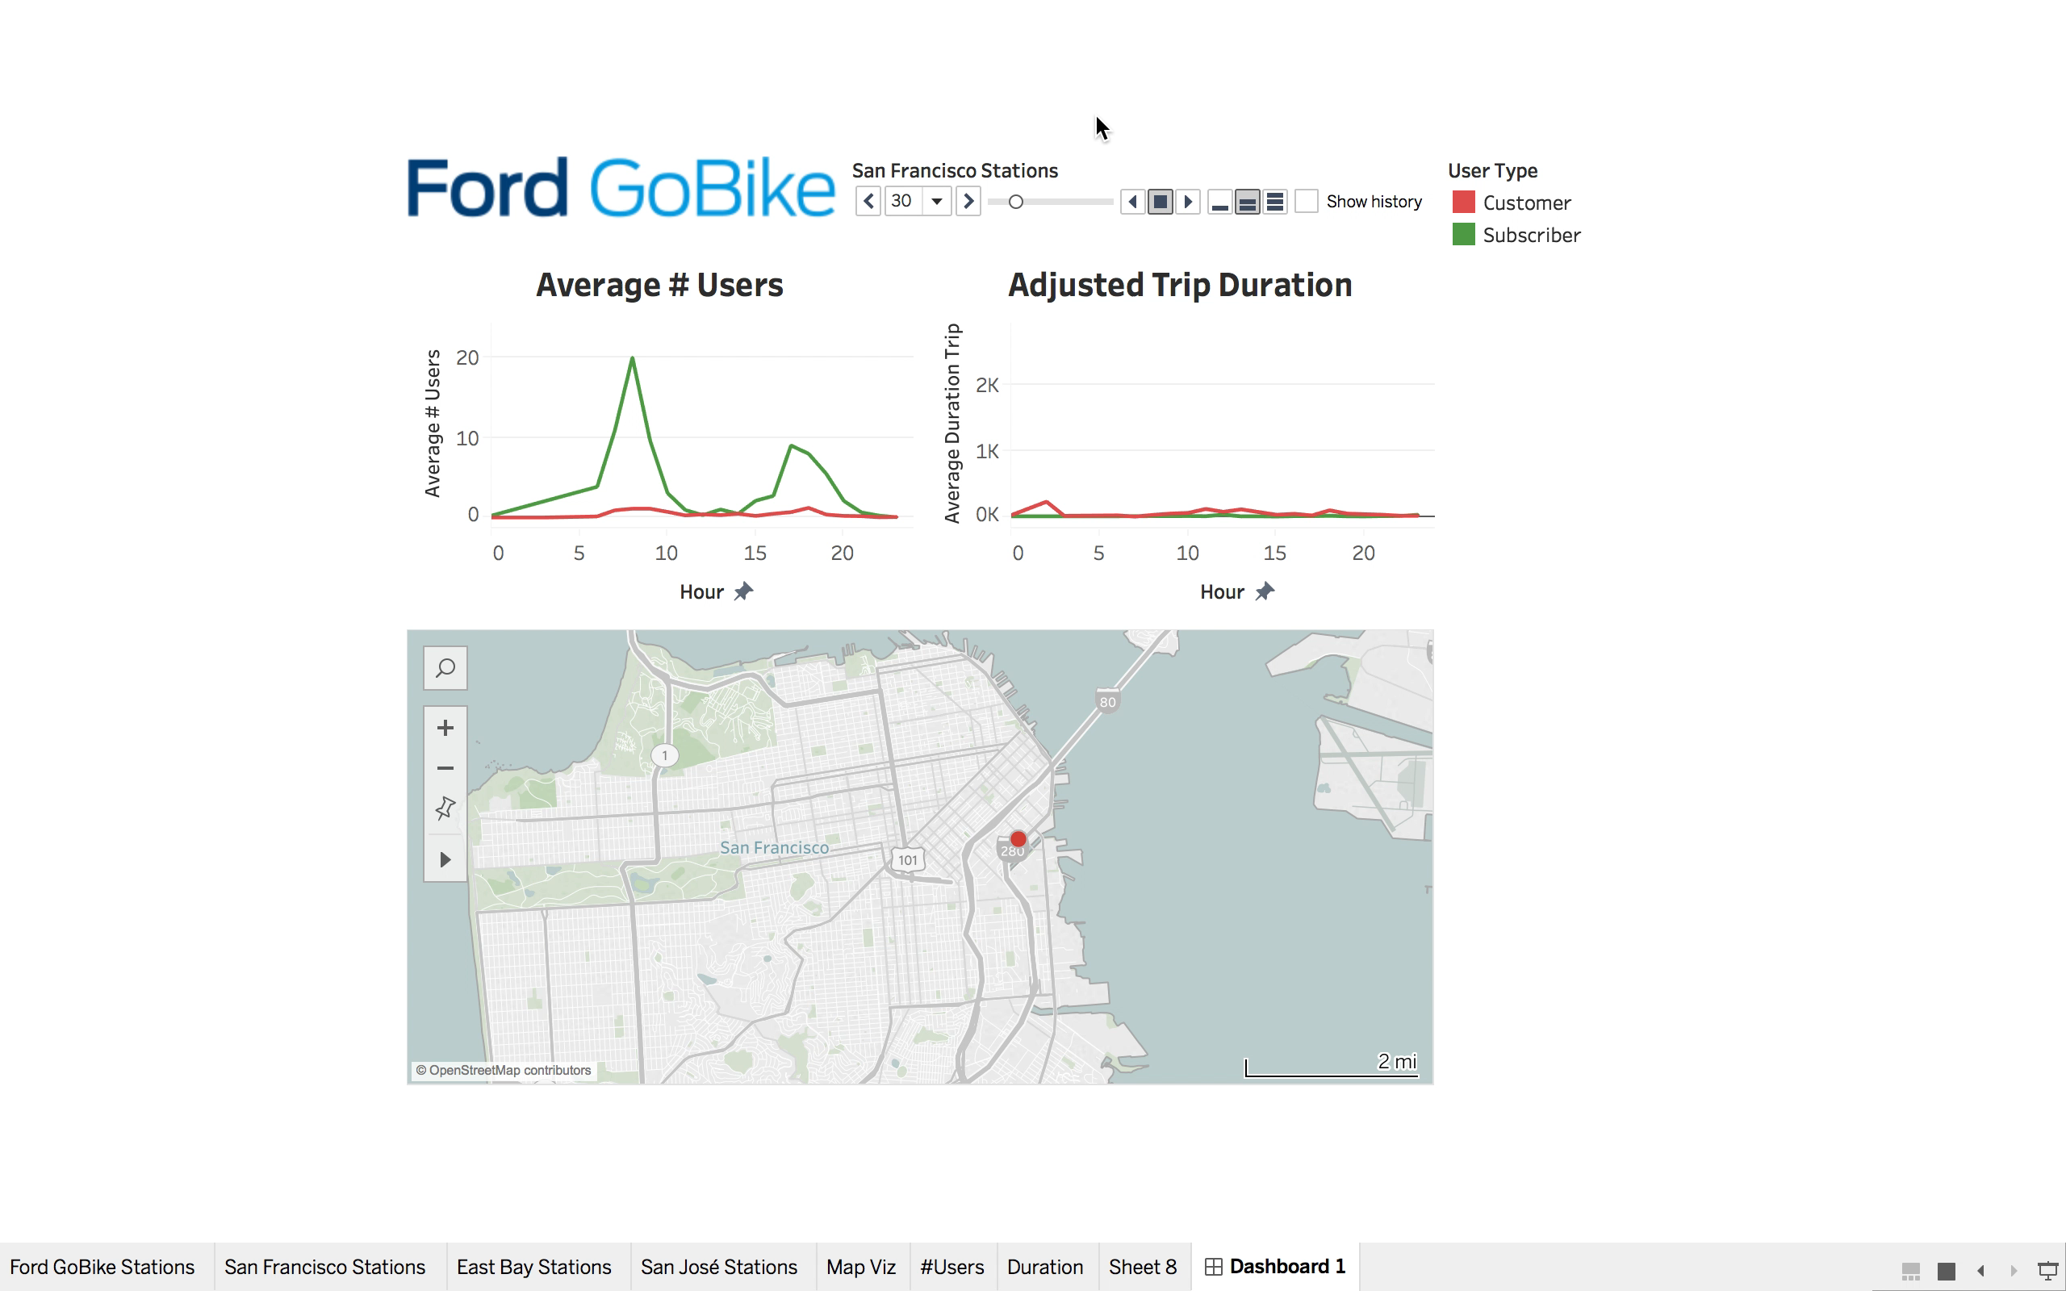
Dashboard Demo
6
BUSINESS
ACTIONS

Slide 14




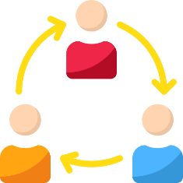
New Trends and Opportunities
APP-BASED MODEL
INNOVATIVE
DOCKS
NEW
WHEELS
P2P
BIKE-SHARE

Slide 15

THANKS FOR YOUR ATTENTION
Q&A

